Slide 1
СУБД
Лекция 5

Slide 2
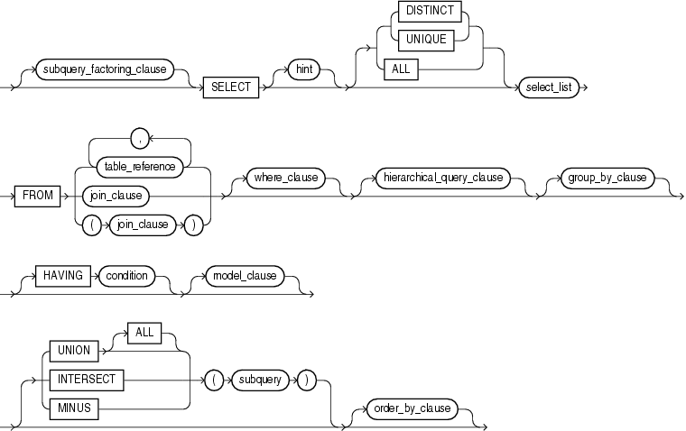
Выборка данных

Slide 3
Выборка данных из одной таблицы
SELECT имена_полей
FROM название_таблицы;
SELECT *
FROM название_таблицы;

Slide 4
ROWID
Select rowid, column1
From tab1

Slide 5
Арифметические действия над датами
SELECT TO_DATE(’31.07.2015’)+2
FROM dual;
02.08.2015
SELECT TO_DATE(02.08.2015)-TO_DATE (’31.07.2015’)
FROM dual
2

Slide 6
Конкатенация строк
SELECT CONCAT(‘Hello ’,’world’)
FROM DUAL;
SELECT ‘Hello’||’ ‘||’world’
FROM dual

Slide 7
NVL
SELECT first_name, last_name, nvl(middle_name,’’)
FROM persons

Slide 8
Case
Case
входное значение
WHEN условие THEN результат
…
END

Slide 9
Символьные функции
Функция | Описание
Lower | Приведение к нижнему регистру
Upper | Приведение к upper регистру
Initcap | Первая буква заглавная
Concat | конкатенация
Substr | Выделение подстроки
Length | Длина строки
Instr | Поиск подстроки в строке
Lpad | rpad | Добавление символов слева | cправа
Trim | усечение
replace | Замена подстроки

Slide 10
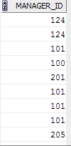

DISTINCT
select manager_id from employees; | select distinct manager_id from employees;

Slide 11
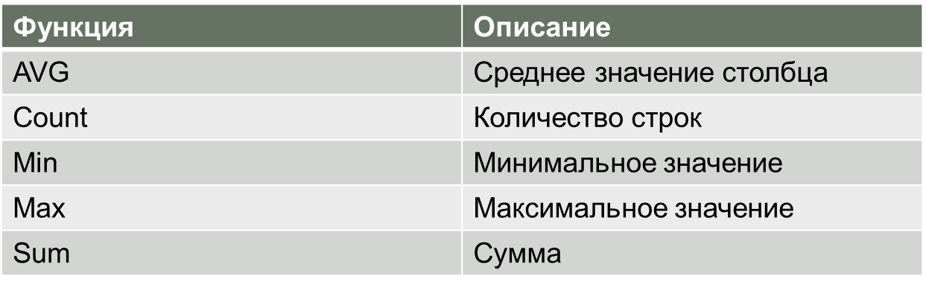

Агрегатные функции
select sum (salary) from employees where department_id=10;

Slide 12
Группировки
SELECT count(employee_id), department_id
FROM departments
GROUP BY department_id

Slide 13
Объединение таблиц
Горизонтальное объединение
Вертикальное объединение

Slide 14
Natural join
Объединение по одинаковым названиям.

Slide 15
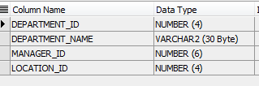
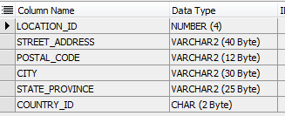
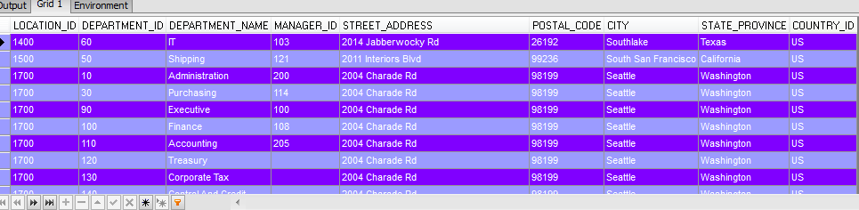
SELECT * FROM departments NATURAL JOIN locations;

Slide 16
Объединение с использованием USING
SELECT *
FROM departments JOIN locations USING (location_id)

Slide 17
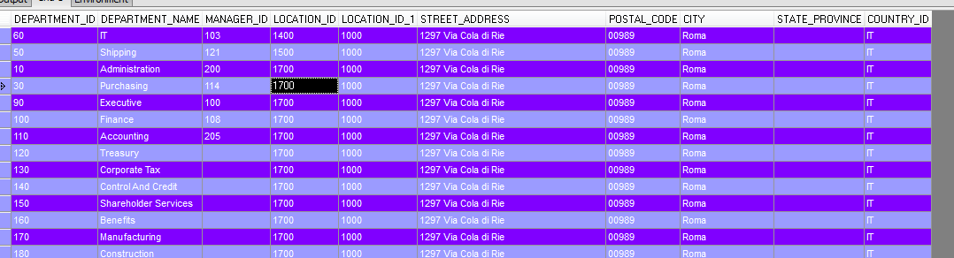
Объединение с использование on
SELECT *
FROM departments d JOIN locations l ON (d.location_id > l.location_id)

Slide 18
SELECT *
FROM departments d, locations l
WHERE d.location_id > l.location_id

Slide 19
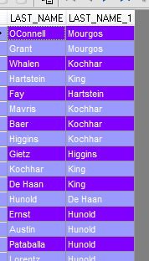
Self join
SELECT
E1.LAST_NAME, E2.LAST_NAME
FROM employees e1
JOIN employees e2
ON (E1.MANAGER_ID = E2.EMPLOYEE_ID)

Slide 20
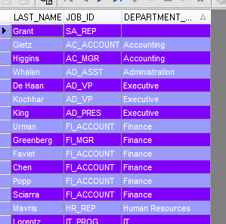
Outer join
SELECT
e.Last_name,
e.job_id, d.department_name
FROM employees e
LEFT OUTER JOIN departments d ON (E.DEPARTMENT_ID = D.DEPARTMENT_ID)

Slide 21
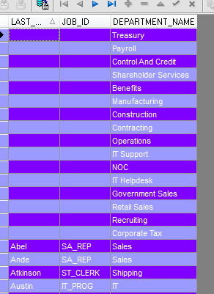
Outer join
SELECT e.Last_name, e.job_id, d.department_name
FROM employees e
RIGHT OUTER JOIN departments d ON (E.DEPARTMENT_ID = D.DEPARTMENT_ID)

Slide 22
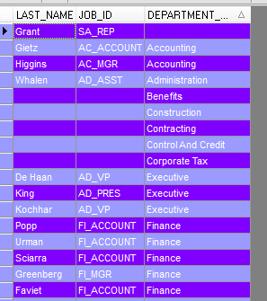
Outer join
SELECT e.Last_name, e.job_id, d.department_name
FROM employees e
FULL OUTER JOIN departments d ON (E.DEPARTMENT_ID = D.DEPARTMENT_ID)

Slide 23
Cross join
SELECT e.Last_name, e.job_id, d.department_name
FROM employees e
CROSS JOIN departments d

Slide 24
Cross join
SELECT e.Last_name, e.job_id, d.department_name
FROM employees e, departments d

Slide 25
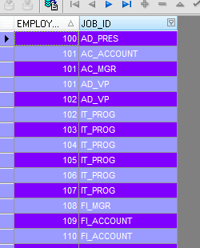
Union
select employee_id, job_id
from employees
union
select employee_id, job_id
from job_history

Slide 26
Union all
select employee_id, job_id
from employees
Union All
select employee_id, job_id
from job_history

Slide 27
intersect
select employee_id, job_id
from employees
intersect
select employee_id, job_id
from job_history

Slide 28
minus
select employee_id, job_id
from employees
minus
select employee_id, job_id
from job_history

Slide 29
Connect by
SELECT LEVEL NAME, ID, PARENT_ID
FROM EMPL
CONNECT BY PRIOR ID = PARENT_ID;
SELECT NAME, ID, PARENT_ID
FROM EMPL
CONNECT BY PRIOR ID = PARENT_ID
START WITH ID IN (SELECT ID FROM EMPL WHERE PARENT_ID IS NULL);

Slide 30
SELECT NAME, ID, PARENT_ID, LEVEL
FROM EMPL
CONNECT BY PRIOR ID = PARENT_ID
START WITH ID = 1;

